Slide 1
Not So Innocent: Toddlers’ Inferences about costs and culpability
- Sudha Mallavarapu

Slide 2
Table of Contents
Introduction
Proposal
Experiment 1
Experiment 2
Conclusion
References

Slide 3
How do you decide what you decide?
Consider two hypothetical scenarios where you try to save lives of four people by hurting one person
Scenario 1:
Consider you are driving a car and were about to hit 5 people if you keep going. If you divert the car just a little bit then you could save lives of four people by killing just one person.
What would you do ??

Slide 4
How do you decide what you decide?
Scenario 1:
Consider you are driving a car and would hit 4 people if you keep going. If you divert the car just a little bit then you could save lives of four people by killing just one person.
Result:
95–97% of the population would turn the wheel.

Slide 5
How do you decide what you decide?
Scenario 2:
You are watching from a distance that a trolley is rushing towards four workers and you have a chance to save them by pushing a very large man on to the track to save them.
What would you do now?

Slide 6
How do you decide what you decide?
Scenario 2:
You are watching from a distance that a trolley is rushing towards four workers and you have a chance to save them by pushing a very large man on to the track to save them.
Result:
95% of people would not want to kill that fat man to save the lives of four people.

Slide 7
Introduction
How adults make a decision?
Based on their perception of other people’s competence and
motivation
Eg. Sally’s Help
Are children’s social evaluations affected by the costs agents incur?
On what basis do children distinguish between agents?

Slide 8
What did we learn about infants so far?
Infer false beliefs
Can distinguish helpers, hinderers and bystanders.
Predict behavior based on social dominance
predict actions based on social dominance
judge third party agents transitively, based on how they interact with moral transgressors and
consider agents’ knowledge about a target agent’s preferences in making moral judgement

Slide 9
The discovery of infants’ sophisticated social intelligence is among the most exciting recent developments in the field of cognitive science.
Question: What are the computations that underlie these judgements?
We propose that the ability to compute the costs and benefits of actions forms the heart of a naive utility calculus that supports inference at the earliest stages of children’s theories of agency

Slide 10
Adult Social Evaluation
Influenced by our perception of how much an action will cost the agent who performs it.
Ex. Sally, watches a child struggle to reach a package on the top shelf of a grocery store.
How do you Judge Sally
If she is 4’ 11’ tall (praiseworthy)
If she is a NCAA Division 1 basketball player (reprehensible)

Slide 11
What analysis underlies this inference?
Observers automatically compute the cost of actions in evaluating and predicting agents’ actions such as
Competence: The perceived cost of an action
Motivation: The perceived benefits of the action to the agent
High Motivated agent Fail Incompetent
High Competent agent Fail Unmotivated

Slide 12
How do we judge moral bystanders?
May not be treated guilty if a helpful action is costly to perform
Would be judged harshly if they fail to help because they find it insufficiently rewarding
Ambiguity arises when agents fail to perform costly actions and do perform low-cost ones.
Eg: Sally Doesn’t want to help? Or
Is Sally trying too hard to help?
These are part of a general calculation of a cost function that is used to reason about goal-directed behavior

Slide 13
Proposal
We test the prediction that very young children can estimate the cost functions associated with agents’ actions and that this analysis affects children’s moral judgments.
This is accomplished through two experiments
Experiment 1: Early Competence Attribution
Experiment 2: Competence and Social Evaluations

Slide 14
Experiment 1
Aim
To test whether toddlers can use the time and effort associated with achieving a goal-directed action to estimate the cost of the action to the agents and whether toddlers have an early preference for competent agents.
Participants
24 toddlers (range 16.8-28 months, 16 males)

Slide 15
Experiment 1
Stimuli
Participants were shown two puppets and a yellow cylindrical toy with a black button at the top. The toy played music when the button was pressed
Procedure
Experimenter introduces the toys to the kids.
Each puppet takes turn to press the button and play the song.
The competent agent was always able to make the toy play music on the first attempt whereas incompetent agent tried several times.
Child was asked to pick one of the puppets they would like to play with.

Slide 16
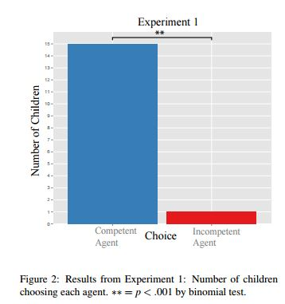
Experiment 1
Results
A total of 8 children were excluded from the analysis, 4 by decision of a blind coder, 1 for parental interference and 3 children who failed to make a choice.
Out of 16 children, 15 children preferred the competent agent.

Slide 17
Experiment 1
Conclusion
Experiment 1 give strong evidence that by 18 months, children distinguish agents from differential cues to competence and prefer agents who appear to incur fewer costs to achieve a goal.

Slide 18
Experiment 2
Aim
How does children’s judgment of agent competence affects their social evaluation
Participants
Seventeen two-year-olds(26 – 34 months) and Thirty three-year old(36 – 50 months) for a test condition and
An additional of 9 three-year-olds were recruited for a control condition
Stimuli
Participants were shown two puppets and a yellow cylindrical toy with a black button at the top. The toy played music when the button was pressed

Slide 19
Experiment 2
Procedure
The protocol in Experiment 1 was identical to the protocol in Experiment 2 with slight exceptions. The experiment was performed under two conditions as follows:
1. Test condition
After the experiment parent picks up the toy and asks one puppet at a time and asks ”Can you help me make the toy go?”.
Each puppet says no and hides under the table.
Presenter finally says, “No one seems to want to help!”

Slide 20
Experiment 2
2. Control condition
After the experiment parent picks up the toy and asks one puppet at a time and asks, ”Do you have a toy like this at home?”.
Each puppet says no and hides under the table.
Presenter finally says, ”No one seems to have this toy!”

Slide 21
Experiment 2
Results
Test condition
Sixteen 2-year-olds and 26 3-year-olds were analyzed in the test condition (11 children were excluded because of failure to make a choice, parental interference and coders decision)
Control condition
Eight 3-year-olds in the control condition (1 was dropped because of failure to make a choice).

Slide 22
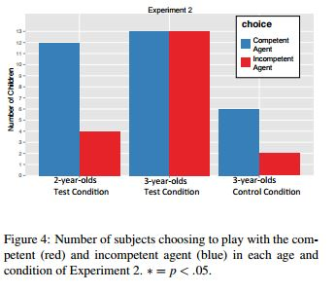
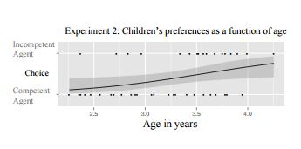
Experiment 2
Results
An effect of age on children’s preferences was observed: older children were more likely than younger children to choose the incompetent puppet

Slide 23
Experiment 2
Discussion
These results suggest that by the age of three, children can override a preference for competent agents if those agents act as moral bystanders.
Given that it is morally objectionable to refrain from helping when a helpful action is relatively low cost, three-year-olds seem to be able to look more favorably on agents who have the excuse of incompetence to exonerate them.

Slide 24
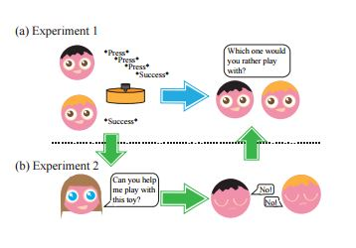
Review

Slide 25
Conclusion
This study show that human beings are sensitive to the cost of actions very early in development and form an early preference for competent agents.
As children progress through early childhood, they become increasingly able to use inferences about an agent’s competence to draw inferences about the agent’s moral status.
At an age when children themselves are still largely both incompetent and innocent, their ability to understand how the one characteristic might bear upon the other suggests remarkably sophisticated inferential abilities and highlights the importance of building a new theoretical synthesis for understanding the development social reasoning.

Slide 26
References
Ettinger, J., Tenenbaum, B,J., Schulz, E,L., Not So Innocent: Toddlers inferences about costs and culpability, Massachusets Institute of technology, Brain and Cognitive Sciences, Cambridge, Ma.

Slide 27


